Slide 1
AUGMENTED REALITY (AR) FOR WAREHOUSE OPERATIONS
Authored and Presented by
Rasika Devanhalli

Slide 2

PRESENTER BIO
Third Year IT student at Cummins College of Engineering, Pune.
Assistant Operations Secretary of IT Branch in Student Panel.
Incoming Software Engineering Intern at Microsoft India.
Runner Up at Citi Code Challenge 2022.
WE Local Scholarship recipient by SWE India.
Harmonium Player and Music Lover.
01

Slide 3
PROBLEM STATEMENT
Augmented Reality (AR) for Warehouse Operations: Develop an AR-based system that provides warehouse workers with real-time visualizations and instructions, enabling faster and more accurate order picking and inventory management.
In context of given problem statement the system has to be generated such that it optimizes operations in Warehouses with the help of Augmented Reality. The operations such as Warehouse Planning,
Order planning, Inventory Management, Conveyer Belt faulty item
Detection and many such operations can be optimized.
This will provide more safety in Warehouse and vulnerability will be prevented from Warehouses.
02

Slide 4
CURRENT PROCEDURES
Currently all Warehouse operations are done manually and hence there are many faults and loss taking place in Warehouses there has to be some solution for this to make more digital procedures by using new emerging technologies
The process of order picking is done manually all goods location, stock, quality are check by people and this can result in errors such as
inaccurate locations of goods, quality tampered and many more.
Inventory management is done manually employees have to physically rush around the warehouse to manually check whether the stock should be replenished, is good-to-go, or is in the right condition.
On conveyer belts all processes are done manually and if a faulty item is detected automation systems requires a lot of resources to detect is rather using AR can detect it with very less resources by just adding a AR component on the item.
03

Slide 5
USE OF AR IN WAREHOUSE OPERATIONS
WAREHOUSE PLANNING
The capabilities of the modern warehouse extend far beyond just a distribution center. To be more precise, the modern-age warehouses serve as a center to carry out more sophisticated services like product subassembly, which includes inspection, assembly, repairing, repacking, and dispatching. This means that apart from the regular operations, warehouses also offer additional value-added services that require continuous monitoring and accurate service delivery.
AR can be of great help to warehouse managers and staff in the overall planning of the warehouse layout. With its potential to create digital, interactive 3D warehouse layout, AR offers the opportunity to experiment with changes to the existing warehouse design.
04

Slide 6
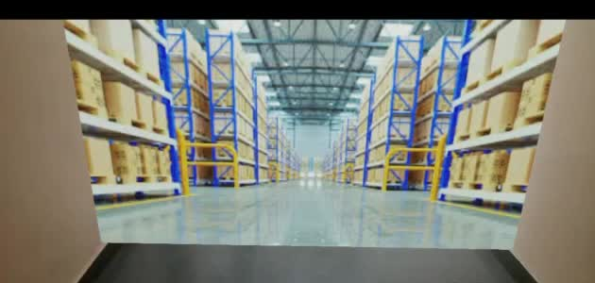
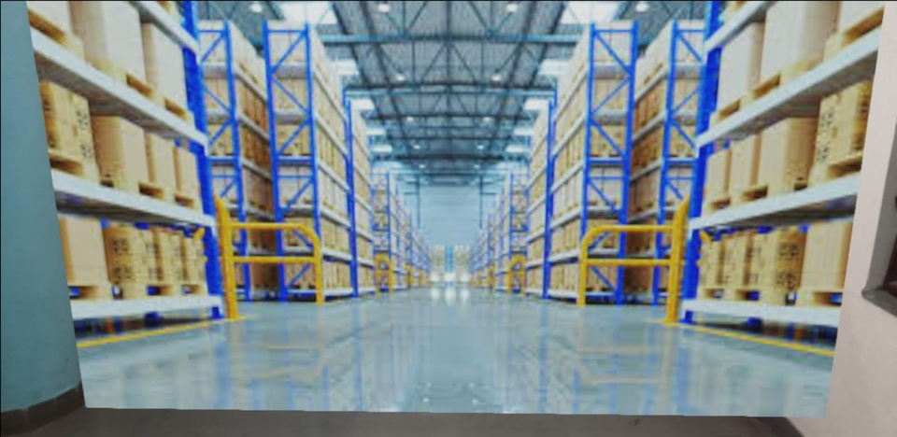
USE OF AR IN WAREHOUSE OPERATIONS
WAREHOUSE PLANNING (Demo Video and Image)
05

Slide 7
USE OF AR IN WAREHOUSE OPERATIONS
In this demo the purpose is to showcase that if we have a free space and have to set up a warehouse, We can simply take that place as a marker and augment a 3D image or object of the warehouse design.
This is a very helpful operation as only a design of Warehouse is not enough to create an actual warehouse.
In addition to this a complete product can be developed in which every single component of a Warehouse can be placed using AR.
06

Slide 8
USE OF AR IN WAREHOUSE OPERATIONS
ORDER PICKING
A very important and cost-intensive task ( which accounts for upto 55 percent of the total operation cost) in a warehouse is order picking. Extracting the right product as requested by customers at the right time and in the right quantities is what order picking is all about.
Using AR we can use AR headset or a simple mobile camera to scan the item placed on a rack and can see what that item is. This is very useful technique to determine the ordered item to pick.
In coming slide a demo of this process is shown by using images on internet and a system of AR that depicts or augments item on the same.
07

Slide 9
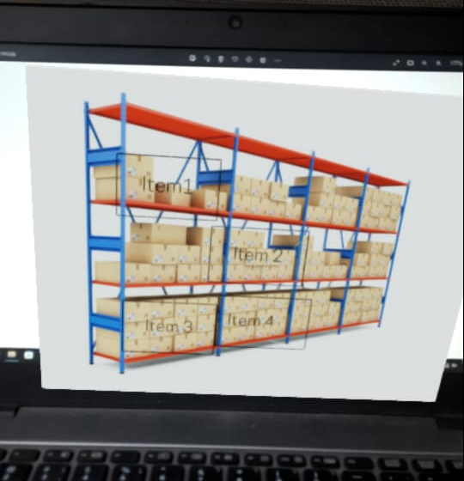
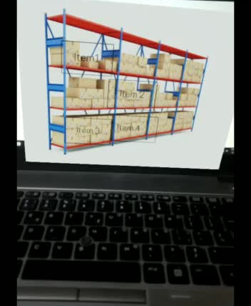
USE OF AR IN WAREHOUSE OPERATIONS
ORDER PICKING (Demo image and video)
08

Slide 10
USE OF AR IN WAREHOUSE OPERATIONS
In this demo taking a rack of a warehouse, we by just seeing the image of warehouse on pc can see augmented tag of Item 1, Item 2, etc. on the item placed on rack of a warehouse.
This can be extended further to add information such as item name, item code, expiry date, and many more feature to the tag.
This augmentation is done using a online cloud based tool available for AR called Overlyapp. This tool is used to create augmented objects without any coding or installations. Markers, elements and other AR attributes can be easily added in a given boundary.
09

